Slide 1
Probability Distributions

Slide 2
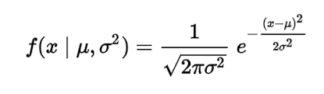
Normal Distribution - We’ve talked about this already…?
Parameterized by mean average and standard deviation

Slide 3

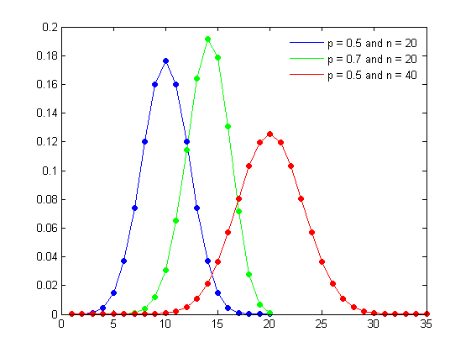
Binomial
Probability of success or failure outcome in an experiment conducted multiple times
Has a BInary set of outcomes, aka yes or no
n = number of times the experiment is run
p = probability of the outcome in question
Similar to Bernoulli distribution with n = 1
Can be used for many / any case where only two outcomes are possible

Slide 4
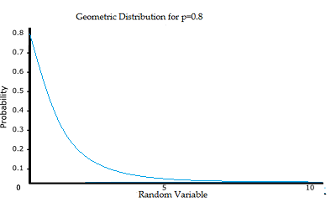

Geometric Distribution
Approximates the number of failures in Bernoulli trials will occur before success
How many people must you ask in a survey before someone says they voted for the Libertarian party
P i= probability of successful outcome
k = trial at which the first success occurs

Slide 5
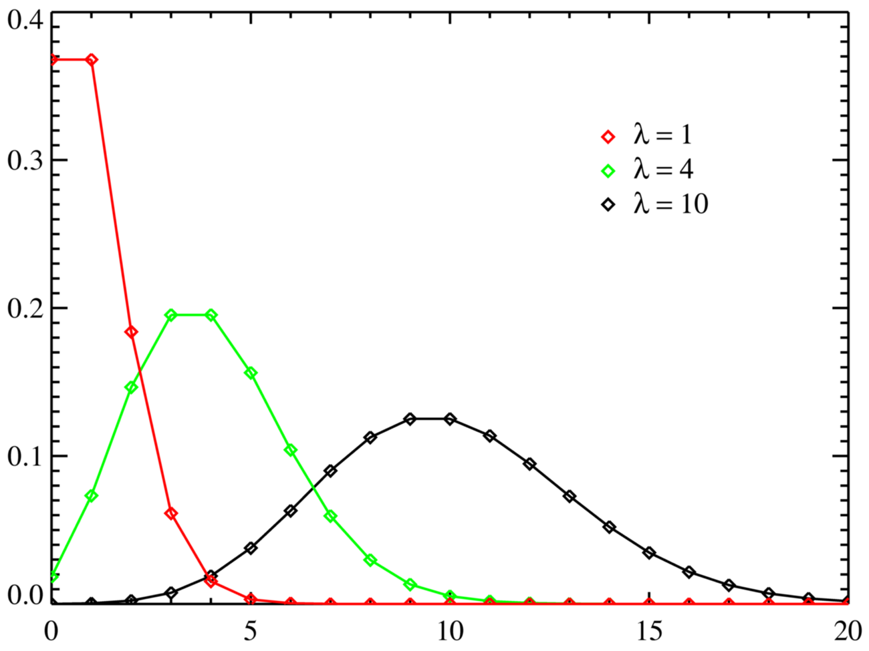
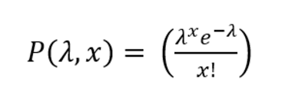
Poisson Distribution
Probability of certain events occurring when you know how often the even has occurred in the past
Assumes fixed interval
Lambda is only parameter and is the “event rate”
X = number of outcomes we’re testing

Slide 6
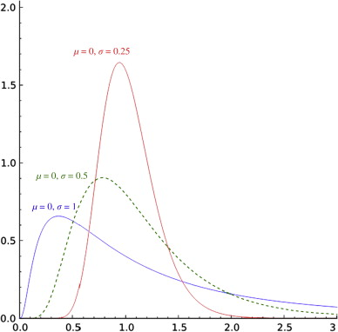
Lognormal Distribution
Distribution wherein the logarithm of the series’ values is normally distributed
Paramters are mean, and standard deviation
Used for various phenomena that are better described by lognormal than normal.
Used for failure rates
Rainfall?

Slide 7
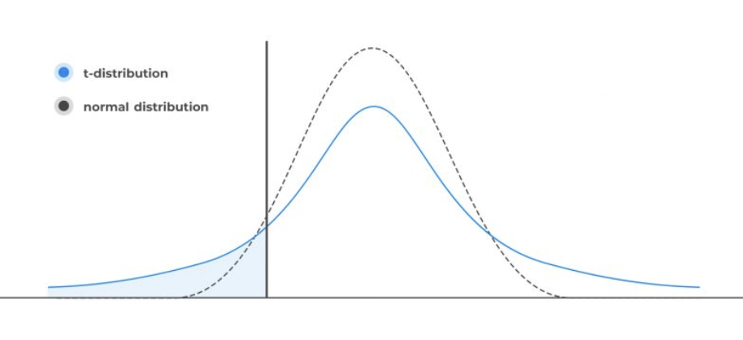
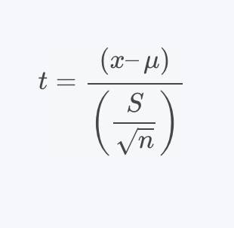
T-Distribution
Also called “Student’s T-Test
Similar to normal distribution, but with fatter tails, meaning extreme values are more likely to occur
Used for hypothesis testing

Slide 8
Geometric Distribution
Approximates the number of failures in Bernoulli trials will occur before success
How many people must you ask in a survey before someone says they voted for the Libertarian party
P i= probability of successful outcome
k = trial at which the first success occurs

Slide 9
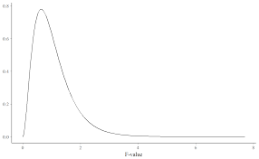
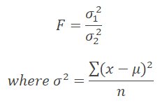
F-Distribution
Used for hypothesis testing

Slide 10
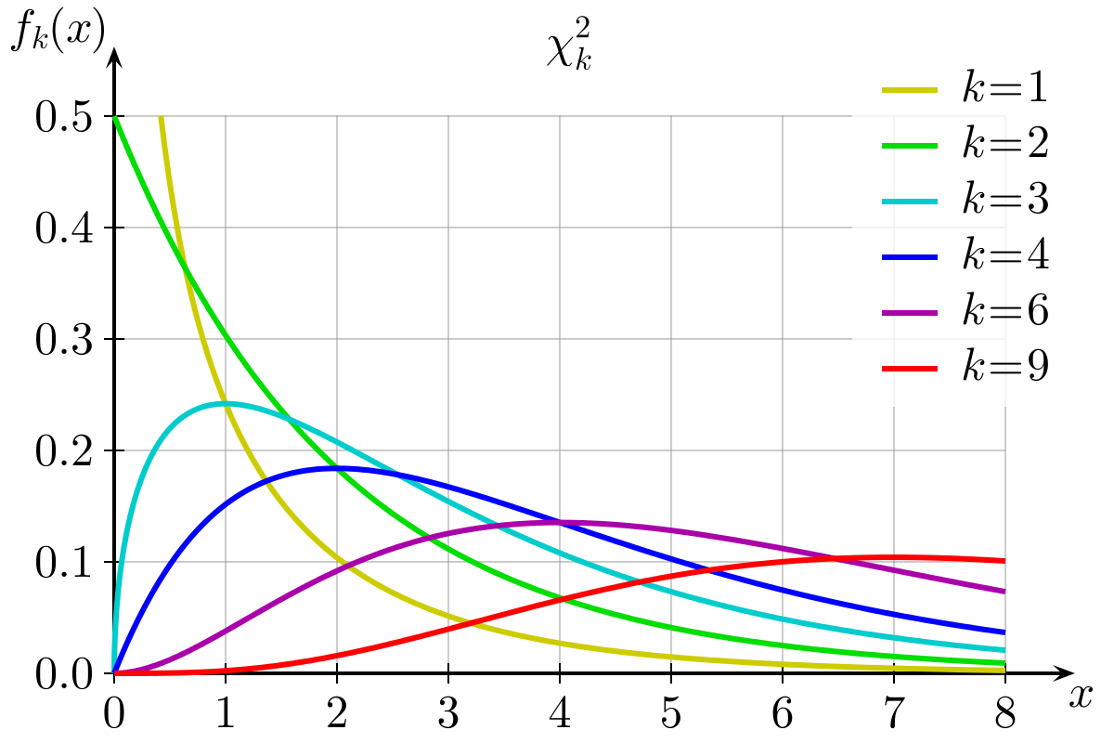
Chi Square

